Slide 1
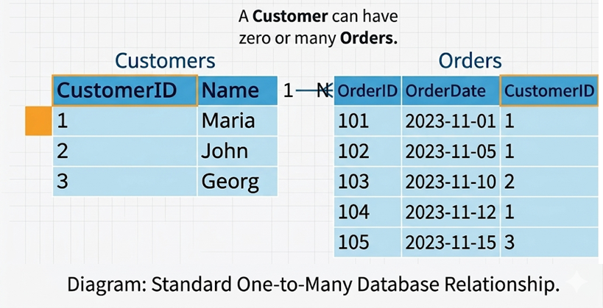
Relationships:
One-to-many
One to One
One-to-many

Slide 2
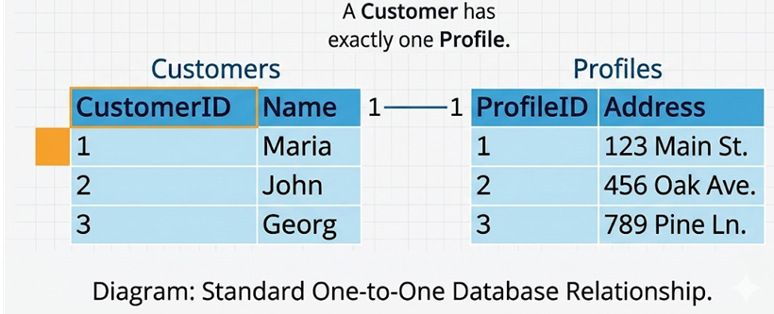
One-to-One

Slide 3
Joins VS Relationships Relationships are logical links between tables where Tableau combines data dynamically at query time, preserving each table's level of detail and reducing duplication. Joins physically merge tables into one table before analysis, Tableau generally recommends using relationships unless a specific use case requires a join.

Slide 4

Data blending in Tableau is the process of combining data from multiple data sources by matching a common field, so you can analyze them together in a single visualization.

